Slide 1
Ease OF Life Tattoo
Dan Tolman

Slide 2
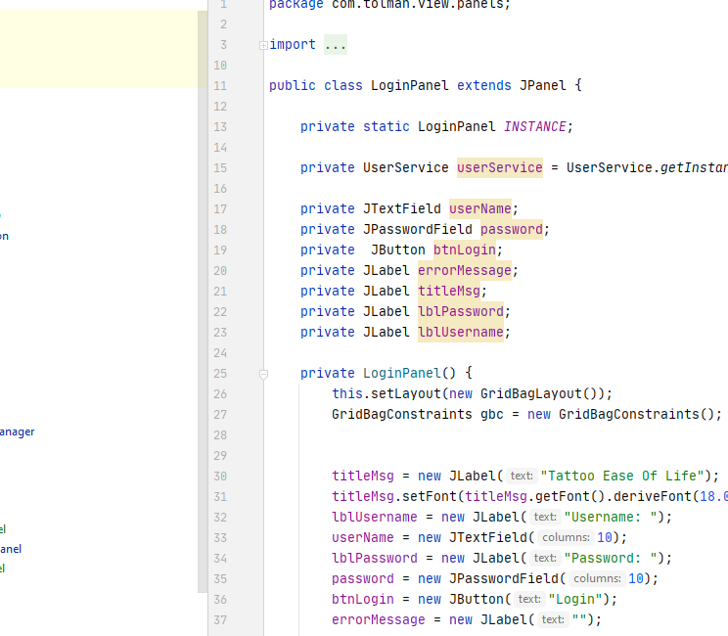
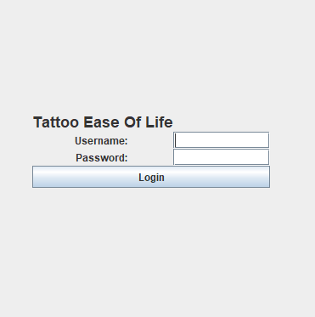
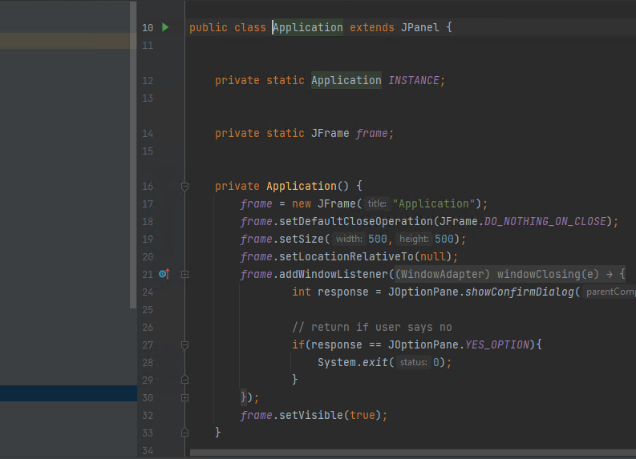
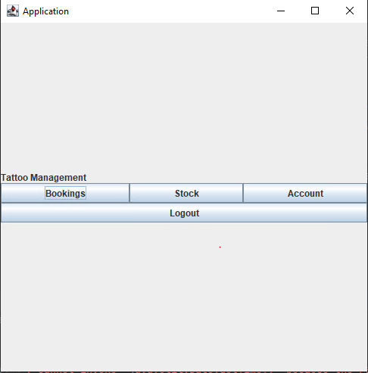
Functionality
Bookings: to be created, deleted & updated to a database
Stock: to be created, deleted & updated to a database
User Accounts: to be created, deleted & updated to a database
Login System: require username and password that matches database to access application

Slide 3
Sprints & Changing languages
Project started as website using React.js & GoLang
Project became application based using Java & SQLite
Sprint planning and time keeping was affected due to this
Basic principles of requirements and sprints were kept; order of priority
Testing issues: Hashing login, Login, Booking dates

Slide 4
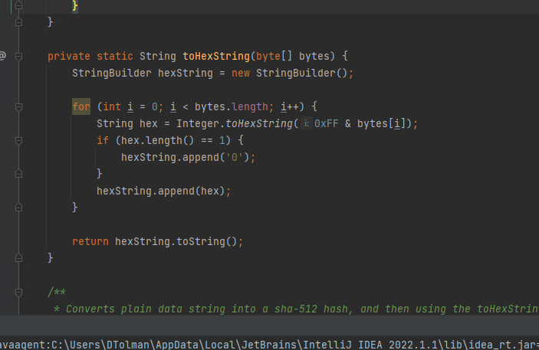
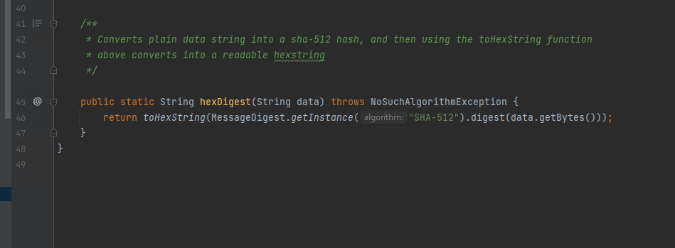
Hashing Passwords
Passwords are turned from plaintext to scrambled representations of itself, known key is used to them unscramble when appropriate
Testing Issue
The database when validating the password was struggling with it being hashed, this was fixed so that the password would be unhashed however the fix is temperamental

Slide 5
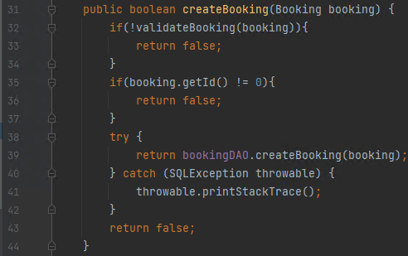
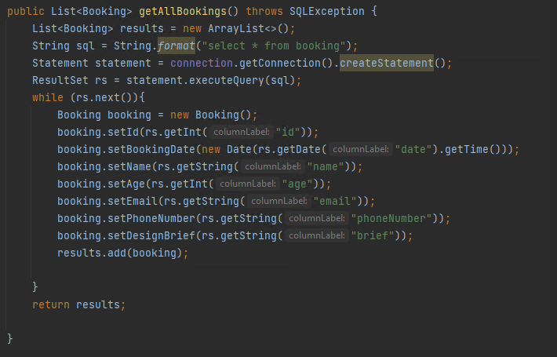
Creating Bookings
When the datatable receives user inputs, it will call validateBooking to ensure that all of the inputs are as expected per entity; is name a string.
When the save button is pressed, bookingDAO is called to run getAllBookings in order to retrieve all current bookings, and add any new additions to the database.

Slide 6
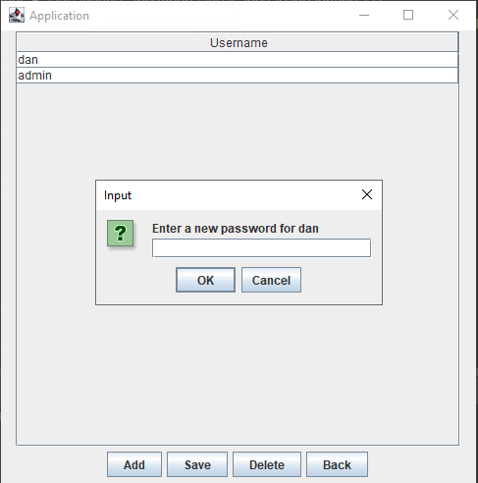
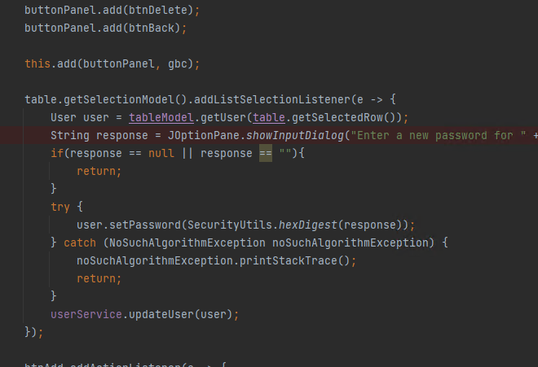
Change password
due to the passwords not being stored in plaintext, and the security fault of displaying passwords, the accounts page only shows usernames with the pop up to change passwords

Slide 7
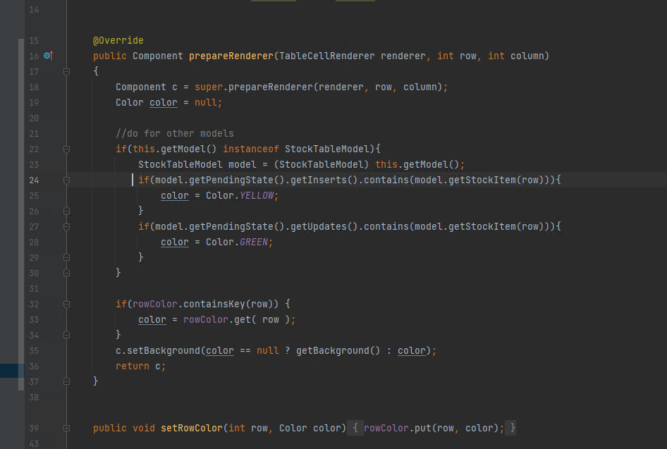
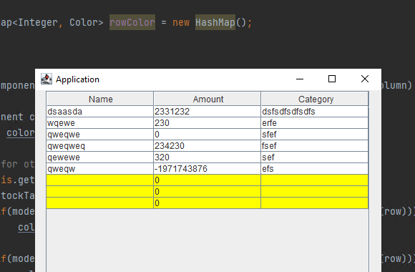
Highlighting to display if contents are saved
The datatable will change colour of the rows depending on the save state of each created entity
If the item is saved okay, it will appear white
If the item requires saving it will appear yellow
If the item is about to be lost unsaved it will appear red

Slide 8
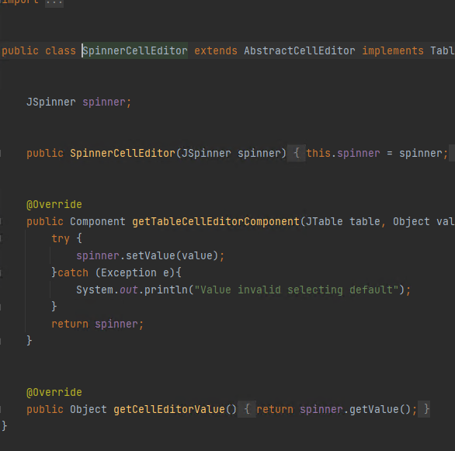
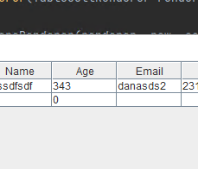
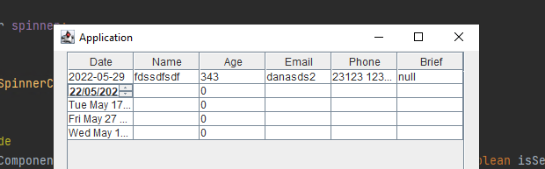
CustomJspinner
A custom spinner was created to allow for easier functionality when inputting a date or stock amount, due to both entities being restricted by set inputs e.g DATETIME

Slide 9
Timeline
GUI & Database
The initial GUI of the all panels was made, database tables created and connection established
Stock Panel & Functionality
Stock class created. Datatable and panel created, calls between panel and database
Booking Panel & Functionality
Booking class created. Datatable and panel created, calls between panel and database. Booking uses customer spinner for dates
Account Panel & Login Functionality
Account class created. Datatable and panel created, calls between panel and database. Login panel created, credential check functionality
Testing & Password Hashing
General debugging and test. Passwords are hashed before being stored on the database

Slide 10
Future Improvements
Improvements
Expanded functionality
Admin account has different view & only account able to create new ones
Visual improvements; include images & color
Login credential check & hashing improvement
Web page front end which will update database which can be viewed using application
Include images of stock
Send user alert for low stock and bookings coming up
Notes:
(These don’t have designer IDs since they were based off the default master slides already in the deck.

Slide 11
How to run
Install IntelliJ
Download .zip from GitHub
Intellij
Install SDK V15
Update drivers
Extract .zip ideally to desktop
Run folder in IntelliJ
https://github.com/DanTolman11/COMP3000-TattooManagementApplication
Check the database file path is correct
Update SQLite drivers
Check database is connected & passwords are correct
Login

Slide 12


Summary
With PowerPoint, you can create presentations and share your work with others, wherever they are. Type the text you want here to get started. You can also add images, art, and videos on this template. Save to OneDrive and access your presentations from your computer, tablet, or phone.

Slide 13


Thank you
Presenter name
Email address
Website

